Slide 1

Feature Extraction & Price Prediction for Mobile Phones
Presented by Shivangi Chaudhary
Company- Nexthikes IT Solutions

Slide 2
Project Overview
Goal
Data Overview
Develop a model to predict mobile phone prices based on features for better pricing strategy and market insights.
Dataset of 600+ phones, including Model, Colour, Memory, RAM, Battery, Cameras, Processor, and Price.

Slide 3
Workflow & Key Features
Workflow Approach
Most Influential Features
01
Processor
Data Exploration & Preprocessing
02
RAM & Internal Memory
Feature Extraction
Rear Camera
03
Model Building
Battery Capacity
04
Evaluation (MAE, RMSE, R²)
Less influential: Colour, AI Lens, Mobile Height.

Slide 4
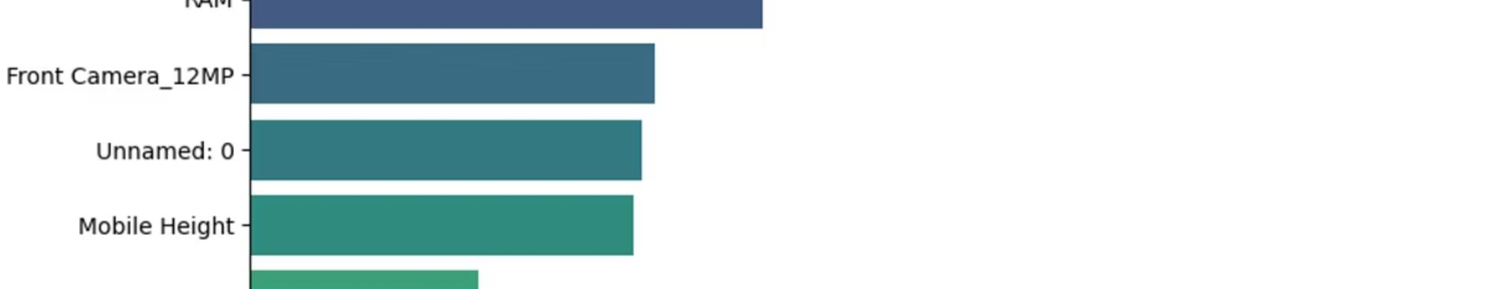
Model & Results
—
2047.03
4950.9
0.822
Best Algorithm
MAE
RMSE
R²
Random Forest and Gradient Boosting
Mean Absolute Error
Root Mean Squared Error
Coefficient of Determination
The model reliably predicts mobile prices based on key features.

Slide 5
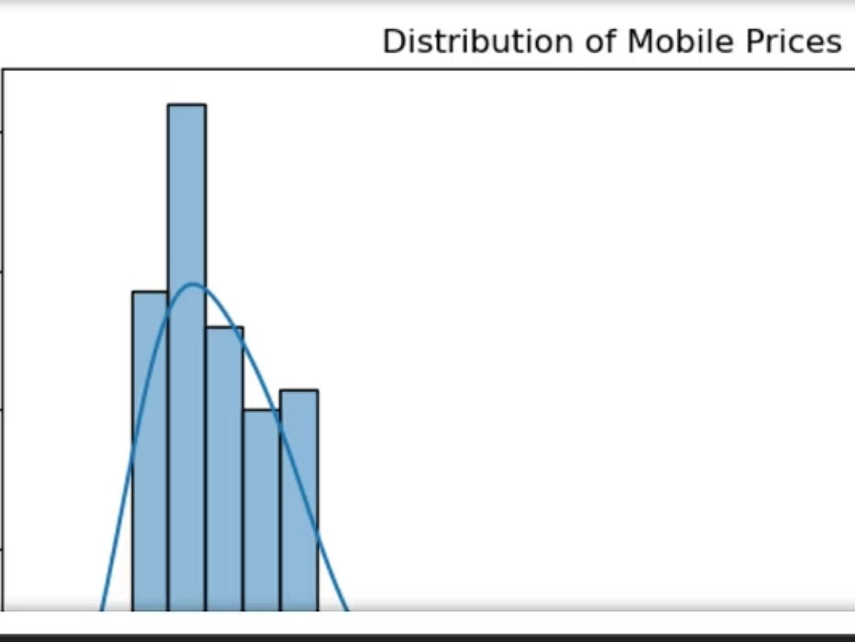
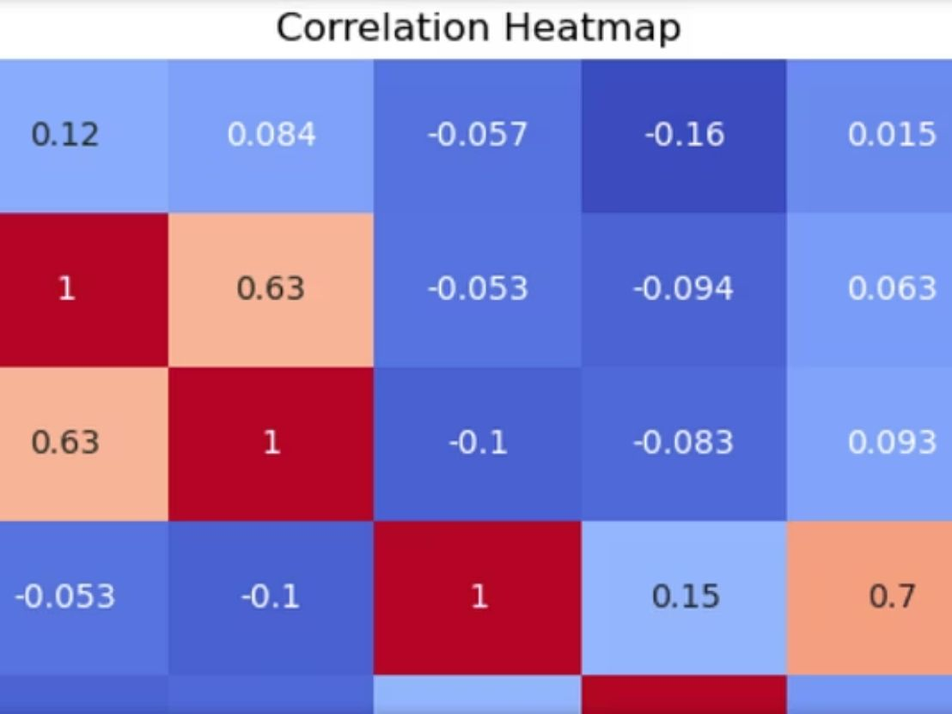
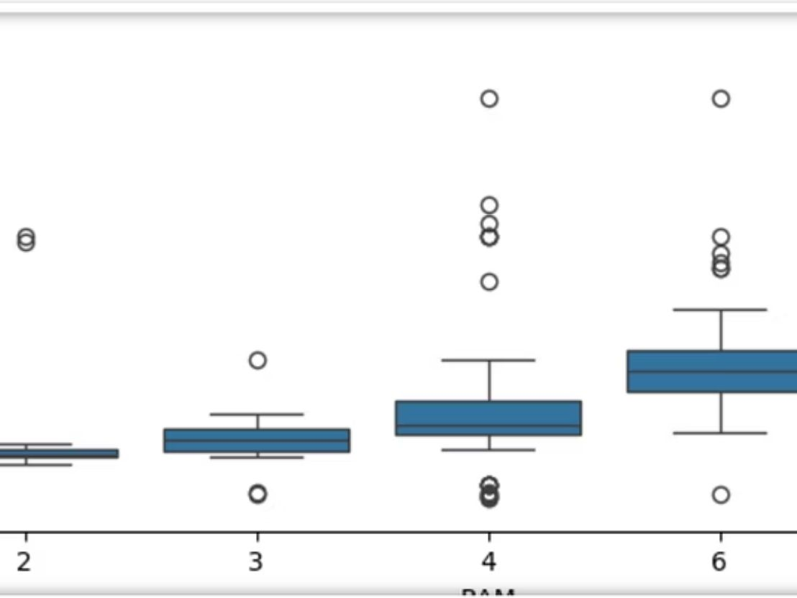
Visualizations
These visualizations illustrate the model's accuracy and the impact of various features on price prediction.

Slide 6

Recommendations
Focus on Key Features
Prioritize high RAM & Memory, powerful Processors, superior Cameras, and larger Batteries in pricing and marketing strategies.
De-emphasize Minor Attributes
Colour, Mobile Height, and AI Lens are less critical for pricing decisions.

Slide 7
References
What is Feature Engineering? - GeeksforGeeks
What is Feature Extraction and Feature Extraction Techniques
All about Categorical Variable Encoding | Towards Data Science
Lec-36: Feature Extraction in Data preprocessing | Machine Learning

Slide 8
Thank You
Thank you for your attention. We hope this presentation offered valuable insights. Please feel free to ask any questions. (Also, the images that I have used in this ppt are from snippets from my projects.)

